Slide 1
BARNET AND SOUTHGATE COLLEGE
FETA

Slide 2
What we can offer
T Level’s – Engineering and Manufacturing T Level, Digital T level and the Digital Level and the construction T Level
Work Experience – Construction, Electrical ,Engineering and business and IT
Lean Manufacturing apprenticeship
Gas Engineering, Carpentry, business, customer service, team leading and process leader apprenticeships
Employability swap programmes and done in any industry ie customer services, construction
Air source heat pumps (Construction) Wire regulations (Electrical)
College Forums

Slide 3
Overview of work experience
Electrical Level 1, Level 2 and Level 3
Engineering Level 1, Level 2 and Level 3
Bricklaying Level 1 and Level 2
Plumbing Level 1, Level 2 and Level 3
Construction Multi-Skills Level 1
Carpentry and Joinery Level 1
Business Level 2 and Level 3
ICT Level 2 and Level 3

Slide 4
- T LEVEL - TECHNICAL QUALIFICATION IN PLUMBING AND HEATING ENGINEERING
Building services engineering- Fundamental Health and Safety practices associated with construction and BSE work; Scientific principles related to construction activities; The construction industry and careers; Principles of sustainability and design, relevant to construction projects; Information, data and principles of measurements; Tools, equipment and materials used in BSE work; Legislation, regulations and approved standards that apply to BSE systems. Plumbing engineering- Fundamental health and safety practices associated with plumbing work; plumbing tools and equipment; Pipework materials, installation methods, and jointing processes; plumbing systems and their purpose; plumbing science, principles of measurement and marking out components and pipework. Heating engineering- Fundamental health and safety practices associated with heating engineering work; Heating engineering tools and equipment; Pipework technology, Heating systems and Heating engineering science.
Career you would go in to after qualification
Plumbing
Domestic Heating/Plumbing/Engineering installation
Technician

Slide 5
T Level’s Course Profile –Electrical & Electronic Engineering T Level
Overview:
Engineering offers a dynamic and thrilling career that involves continuous innovation and advancement of products and systems. Through this T-level program, you'll develop an understanding of how materials, conditions, and contexts shape the design processes and final products. Additionally, you will learn about the business aspects in engineering, delving into areas such as: Customer and client requirements; Principles of design; Design processes; Communication in design This technical qualification primarily concentrates on equipping you with the knowledge and skills required for a successful career in the engineering industry. It will prepare you to enter the industry either through employment or as an apprentice. Furthermore, the successful completion of this program will open doors for you to pursue higher education courses and further training.
Duration:
2-year Programme with 315 Hours on Industry Placement
What will the student study:
The course will include the following topics: Essential mathematics for engineering and manufacturing; Essential science for engineering and manufacturing; Materials and their properties; Mechanical principles; Electrical and electronic principles; Mechatronics; Working within the engineering and manufacturing sectors; Engineering and manufacturing past, present, and future; Engineering and manufacturing control systems; Quality management; Health and safety principles and coverage; Business, commercial and financial awareness; Professional responsibilities, attitudes, and behaviours; Stock and asset management; Continuous improvement; Project and programme management. You will also acquire the technical knowledge and practical skills specific to the Electrical/ Electronics industry, common workplace skills along with relevant Maths, English and digital skills. There is a mandatory 315-hour (45 day) minimum industry placement, which also needs to be achieved.

Slide 6
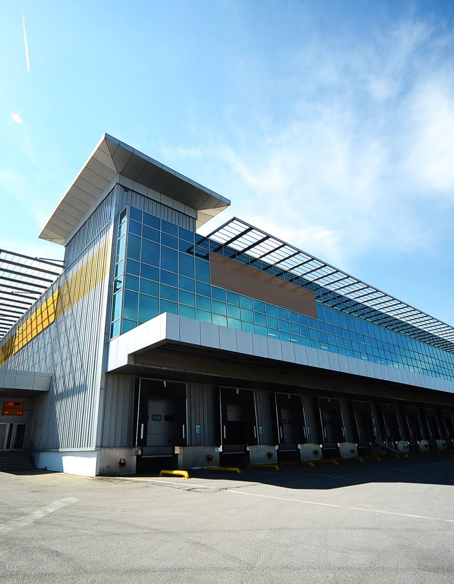
How will the student be assessed at College?
Two externally set exams covering knowledge from the engineering common core. An employer-set project that will consist of a well-defined, real industry-style brief. The brief will be complex and non-routine and will require the use of relevant Maths, English and digital skills. The brief will give you the chance to demonstrate your knowledge and understanding of the core content and your core skills to solve problems that could occur in the workplace. An occupational specialism assessment which is composed of a series of practical tasks relating to the specialism at hand. This will take place over a period, which will be confirmed when you start your course. The course is graded as Pass, Merit, Distinction or Fail.
What qualifications could I achieve:
T Level Technical Qualification in Design and Development for Engineering and Manufacturing (8714) Electrical and electronic engineering Occupational Specialism
Benefits for employer taking on a T Level student:
Offering work experience allows you to inspire and influence the future workers and managers of your industry, and at the same time you'll enhance the reputation of your company in the industry and the local community and do your bit for society and the economy. It gives the employer the chance to shape the future of your industry.
Career you would go in to after the qualification
Electrical Engineer
Project Engineer
Maintenance technicians
System Engineer

Slide 7
T Level Digital Infrastructure Support Services
2 Year Qualification with 315 hours of Industrial Placement with Employer
Students will develop a general understanding of digital: how digital technologies impact business and market environment; the ethical/moral implications of digital technology; using data in software design; using digital technologies to analyse & solve problems; digital environments, including physical, virtual & cloud environments; legal/regulatory obligations relating to digital technologies; privacy and confidentiality of personal data; technical, physical and human aspects of internet security; planning digital projects; testing software, hardware and data; digital tools for project management and collaboration. Students will also study topics specific to digital support services, including roles within digital support services; communication in digital support services; fault analysis & problem resolution.
Career you would go in to after qualification
Network Engineering
Cyber Security
IT Solutions

Slide 8
Course Profile – T Level in Digital Production, Design and Development
Course Profile – T Level in Digital Production, Design and Development
2-year Course with 315 Hour Employer Placement
What will the student study:
T Levels combine classroom and practical learning with industry placement to give students real experience of the workplace. Classroom topics are: DIGITAL ANALYSIS, LEGISLATION AND EMERGING ISSUES - Intro to programming - understanding of problem-solving. EMERGING ISSUES AND IMPACT OF DIGITAL - understanding of ethical and moral issues. LEGISLATION AND REGULATORY REQUIREMENTS IN THE DIGITAL SECTOR: understanding legal issues. THE BUSINESS ENVIRONMENT: An understanding of the business environment; the importance of serving stakeholders. DATA: understanding of the use of data to support business needs. DIGITAL ENVIRONMENTS: understanding different platforms of delivery. SECURITY: understanding of the potential risks posed by digital. OCCUPATIONAL SPECIALIST DIGITAL PRODUCT, DESIGN AND DEVELOPMENT: understanding how to design and develop digital products.
What Job can I do after this qualification:
Developer
Programmer
Data Analyst

Slide 9
Lean Manufacturing Apprenticeships
OVERIVEW:
This is a 16-month apprenticeship that is aimed at those working in the manufacturing industry. A LMO must have core requirements in one specific manufacturing job role. For example, production assembly, inspection/quality, logistics/material handling, production processing/finishing.
HOW WILL MY TRAINING BE DELIVERED:
Delivery will take the form of a series of either blocked weeks or monthly classroom sessions and will be supported by monthly visits to your workplace to assess the development of skills, knowledge and behaviours required to meet the standard. A series of work-based activities and projects will be available to support your learning. Topics covered will include Health and Safety in the Workplace; Communication and Working Effectively; Working Relationships; Individual Rights and Responsibilities; Workplace Organisation; Problem Solving.
WHAT QUALIFICATION WILL BE DELIVERED:
Level 2 Diploma in Lean Manufacturing (Knowledge and Skills) Level 2 Apprenticeship standard as a Lean Manufacturing Operative Functional Skills in English and Maths at Level 2 (as appropriate) Functional Skills in ICT may also be offered

Slide 10
Carpentry Apprenticeships
OVERIVEW:
This is a 24-month apprenticeship those seeking a career as a carpenter and joiner and wish to work on a building site or in domestic or commercial premises. The occupation is suited to those working with wood to create and install building components. This involves shaping and cutting materials, installing finished materials like partitions, doors, staircases, window frames and erecting structural components such as floor joists and roofs.
HOW WILL MY TRAINING BE DELIVERED:
This apprenticeship training will follow the Site Carpentry pathway which will entail preparing and installing basic building components e.g., doors, staircases, wall, and floor units on a building site or in domestic and commercial premises. Your learning will include some of the following topics: The principles of building construction terminology and components including foundations, roofs, walls, floors, utilities and services; How to interpret and produce relevant information from drawings and work instructions including the basic principles of Computer Aided Design (CAD); How to estimate resource quantities to carry out work; Power Tools: how to prepare, use and maintain power tools; How to carry out first fixing work; How to carry out second fixing work; Effective communication: oral, written, listening, body language, presentation; Logical thinking: use clear and valid reasoning when making decisions. Apprentices attend college 1 day per week at our Colindale Campus.
WHAT QUALIFICATION WILL BE DELIVERED:
Level 2 Carpentry and Joinery Apprenticeship Standard

Slide 11
Gas Engineering Apprenticeships
OVERIVEW:
This is a 24-month apprenticeship which is primarily aimed at individuals whose job role involves the safe installation, commission, decommission and the ongoing service and repair of gas appliances in either a domestic or non-domestic setting. Appliances can include a range of work categories such as central heating boilers, unvented hot water storage, ducted air heaters, cookers, space heaters, meters, alternative fuels, boosters, testing and purging for industrial pipework. All gas engineers must be registered on the Gas Safe® Register for each appliance in which they are competent to undertake work on. Those who work within Gas engineering must have the core requirements below and demonstrate the technical requirements in one setting - domestic or non-domestic. They must be registered on the Gas Safe® Register for four appliances.
HOW WILL MY TRAINING BE DELIVERED:
Apprentices attended college 1 day a week and will be in work 4 days per week. Within the Advanced Apprenticeship you will cover core knowledge and skills such as health, safety & environmental legislation. Safe gas and electrical installation, commissioning, decommissioning, service and repair. As well as safe operation of the equipment and installation in accordance with industry standards, theories and procedures. You will also cover a variety of core technical knowledge and skills such as combustion, gas properties, carbon monoxide (CO) and types of burners, flues and ventilation principles. Flue types for appliances & smart controls. On site assessments will take place to support the apprentice with building their portfolio.
WHAT QUALIFICATION WILL BE DELIVERED:
Level 3 Gas Engineering Apprenticeship Standard, Level 3 Gas Engineering Diploma, Gas Safe Registration.

Slide 12
Team Leading Apprenticeships
OVERIVEW:
This is a 16 - month apprenticeship that is aimed at those who are responsible for supporting, managing and developing team members, managing projects, planning and monitoring workloads and resources. Typical job roles include team leaders, first line managers and supervisors from all sectors - private, public or third sector organisations of any size. Attendance on this course is required once every month.
HOW WILL MY TRAINING BE DELIVERED:
Delivery consist of Monthly workshops, online sessions and workplace visits. Topics covered will include; leading and managing people, building relationships, communication, operational and project management, finance and decision making. Attendance on this course is required once every month.
WHAT QUALIFICATION WILL BE DELIVERED:
Team Leader Supervisor Apprenticeship Standard – Level 3 ILM L3 Diploma in Management

Slide 13
Business Administration Apprenticeships
OVERIVEW:
This is a 16- month apprenticeship that is aimed at those who provide administrative services. Your work may include developing, implementing, maintaining and improving administrative services. You should be in a position where you can work independently and take responsibility for the outcomes of your work. You may work for private, public or third sector organisations of any size, and may work across a range of functional areas..
HOW WILL MY TRAINING BE DELIVERED:
Delivery will take the form of a series of monthly classroom sessions to develop the required underpinning knowledge. This will then be supported by monthly visits to the workplace to assess the development of skills and behaviours required to meet the Standard, using a series of work- based activities/projects.
WHAT QUALIFICATION WILL BE DELIVERED:
Business Administrator Apprenticeship Standard

Slide 14
Key Requirements for Hiring an Apprentice
Employ them for a minimum of 30 hours a week (this includes 6 hours spent at college).
Release the apprentice from 6 hours of their working hours for off the job training. This would be for the one- day release at college.
Provide a contract of employment for the duration of the apprenticeship and apprentices must be paid through PAYE.
Provide employer liability insurance.
Participate in reviews with the apprentice and the assessor every 8-12 weeks to feedback on the apprentice’s progress.
Allow the assessor access to the apprentice to undertake assessments within the workplace.
Provide access to the necessary work for the apprentice to complete their competency-based portfolio.
Apprenticeships are available to new recruits and existing members of staff. There is a wide variety of apprenticeships available for almost every industry and business. These apprenticeships range from entry level jobs all the way to degree level and can complement your current learning and development activity.
Existing employed staff can undertake an apprenticeship training programme if new knowledge and skills are required for the job role. This means employers can utilise this training to enhance staff development within the organisation. Our experienced sales team will be able to advice on this in more detail.

Slide 15
Employability course/Short courses
LEVEL 3 AWARD IN THE INSTALLATION AND MAINTENANCE OF HEAT PUMP SYSTEMS:
The qualification will help you gain an understanding of the skills required within the installation and maintenance of heat pump systems You will cover compulsory aspects such as: Vapour compression systems; Fundamental principles of heat pumps; Installation and testing of an air heat pumps; Commissioning an air source heat pump system; Non-refrigerant circuit routine service and maintenance of an air heat pump.

